Slide 1
The Generic Sensor API:
Using your environments as input
Miguel Campos — G2 Software Systems — https://ModestDuck.com/
Demos: http://bit.ly/GS-API

Slide 2
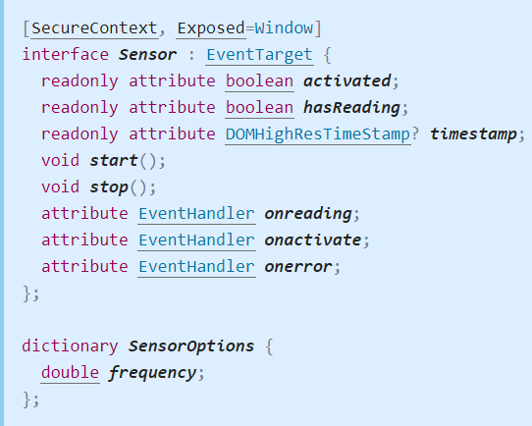
What Is It?
Demos: http://bit.ly/GS-API
The Generic Sensor API is built to promote consistency in exposing sensor data to the Web.
The API provides us with a consistent interface to access our devices’ sensors.
This API is a W3C Working Draft, and is not 100% stable yet.
Notes:
The Generic Sensor API is an interface specification made by the World Wide Web Consortium to promote consistency in exposing a device’s sensor data to the Web.
Device sensors allow us to extract data from our environment for use in our webapps. The API provides us with a consistent interface when attempting to access our devices’ sensors.
This API is a W3C Working Draft, which means the specification isn't stable and we may expect some changes in the future.

Slide 3
Popular Use Cases
Demos: http://bit.ly/GS-API
Modern mobile devices, and web browsers implement several sensors:
Environmental Sensors | Ambient Light Sensor, Proximity Sensor, Magnetometers | Home Automation, Accessibility, Fitness Monitoring, Weather Monitoring
Inertial Sensors | Accelerometers, Gyroscopes | Immersive Gaming, Indoor Navigation Systems, Activity Tracking, 3d Scanning
Fusion Sensors | Device Orientation Sensors, Gravity Sensor, Linear Acceleration Sensor | ∞
Notes:
Modern mobile devices, and web browsers implement several sensors for us to access.
These sensors fall into 3 categories:
Environmental Sensors (Ambient Light Detectors, Proximity Sensors, and Magnetometers) provide information about the environment. Applicable domains: Home automation, accessibility, and fitness monitoring.
Inertial Sensors (Accelerometer and Gyroscope) provide information about forces applied to the device. Applicable domains include: Virtual Reality Gaming, Indoor Navigation Systems, 3d Scanning,
Fusion Sensors (Absolute Orientation Sensor, Gravity Sensor, Linear Acceleration Sensor) are created by combining the readings of two lower-level sensors into one. Linear Acceleration Sensor is composed of the Accelerometer, Magnetometer, and Gyroscope and can be used to detect whether your phone is falling, or if your car is moving without having to do the math.

Slide 4
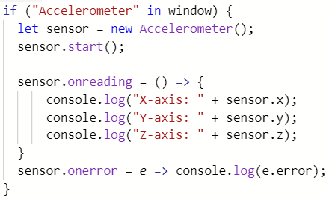
Implementation
Demos: http://bit.ly/GS-API
Feature Detection
Create the Sensor
Start the Sensor.
Subscribe to Events.

Slide 5
Security Risks
Demos: http://bit.ly/GS-API
Location Tracking (Accelerometer, Magnetometer, Ambient Light Detector)
Key Stroke Monitoring (Gyroscope, Accelerometer)
PINLogger.js
Device Finger-Printing (Multiple Sensors).
Notes:
Sensors pose a big risk as they provide high level information about a user’s habits, W3C has identified 3 key risks associated with Sensor Data.
Malicious website can use sensor data from the Accelerometer and Magnetometer to detect a user’s location.
2. Studies have been done which used data from the Gryscope and Accelerometer sensors to guess pin numbers and passwords based off the forces your phone feels when you type your password.

Slide 6
Inconsistencies & Limitations
Demos: http://bit.ly/GS-API
Browser Limitations:
Requires Secure Context (https://)
Requires focus on element or page using sensor readings.
Not all browsers implement (Opera)
Hardware/O.S. Inconsistencies:
Default Orientation may be different on some iPhones.
Notes:
In order to mitigate some of the risk associated with exposing your devices sensor data to the web, W3C has imposed some restrictions on accessing sensor data.
Limitations include:
requiring a user to be in a secure context before providing sensor data,
requiring user’s focus on the window currently requesting access to a Sensor,
additional permissions may be required when accessing sensor data.
It's also worth noting that this API has some known inconsistencies in several browsers and on a number of operating systems. You may have already noticed this by comparing the demo on your phone to your neighbors’ demo.

Slide 7
Sources:
Demos: http://bit.ly/GS-API
W3C's Generic Sensor API: https://www.w3.org/TR/generic-sensor/
W3C's Generic Sensor Use Cases: https://w3c.github.io/sensors/usecases Stealing PINs via mobile sensors: (PINLogger.js) https://rd.springer.com/article/10.1007/s10207-017-0369-x?wt_mc=Internal.Event.1.SEM.ArticleAuthorOnlineFirst
Additional Readings & Examples: https://modestduck.com/generic-sensor-api/
Notes:
In order to mitigate some of the risk associated with exposing your devices sensor data to the web, W3C has imposed some restrictions to the data’s usage.
Limitations include requiring a user to be in a secure context before providing sensor data, requiring user’s focus on the window currently requesting access to a Sensor, additional permissions may be required when accessing sensor data.
It's also worth noting that this API has some known inconsistencies in several browsers and on a number of operating systems.

